Slide 1

Psychopharmacology: Drugs, the Brain, and Behavior
by Meyer, Farrar, Biezonski, Yates

Slide 2
Chapter 10
Alcohol
10.1 Psychopharmacology of Alcohol
10.2 Neurochemical Effects of Alcohol
10.3 Alcohol Use Disorder (AUD)

Slide 3
Chapter 10
Learning Objectives (1 of 3)
10.1.1 Describe the pharmacokinetic fate of alcohol (absorption, distribution, metabolism, and excretion) and explain how factors such as dose and expression of metabolic enzymes affect these processes. and explain how factors such as dose, concentration of alcohol, and sex affect the rate of absorption.
10.1.2 Describe how alcohol may interact with other drugs by competing for metabolic enzymes.
10.1.3 Explain the mechanisms that underlie acute, metabolic, pharmacodynamic, and behavioral tolerance to alcohol.
10.1.4 Identify the CNS-mediated effects of alcohol in terms of dose and describe the withdrawal syndrome that occurs when an individual physically dependent on alcohol stops consuming alcohol.
10.1.5 Describe the health effects of chronic, heavy alcohol use on the brain, cardiovascular system, and liver.
10.1.6 Describe the clinical presentation of fetal alcohol spectrum disorders and list the factors that contribute to the highly varied symptom presentation.

Slide 4
Chapter 10
Learning Objectives (2 of 3)
10.2.1 Describe how animal models can be used to examine the behavioral, neural, and genetic bases of AUD.
10.2.2 Explain how alcohol acutely modulates glutamate neurotransmission, in terms of both pre- and post-synaptic mechanisms.
10.2.3 Describe how the effects of chronic alcohol use on glutamate neurotransmission contribute to excitotoxicity and reduced seizure threshold during withdrawal.
10.2.4 Explain how alcohol acutely enhances GABA-mediated neural inhibition.
10.2.5 Describe how chronic alcohol consumption alters GABAergic neurotransmission.
10.2.6 Identify the evidence for the role of mesolimbic dopamine and brain opioid systems in mediating the reinforcing properties of alcohol.

Slide 5
Chapter 10
Learning Objectives (3 of 3)
10.3.1 Articulate the properties of pathological drinking behavior that give rise to alcohol use disorder (AUD).
10.3.2 Identify the neurobiological changes caused by underage drinking.
10.3.3 Describe how neurobiological, psychological, and societal factors contribute to individual vulnerability for AUD.
10.3.4 Explain how medically supervised detoxification is conducted to mitigate risks associated with alcohol withdrawal.
10.3.5 Describe the mechanisms of action of the three pharmacotherapies for AUD currently approved by the FDA.

Slide 6
Psychopharmacology of Alcohol (1 of 16)
Alcohol has a long history of use
Alcohol use dates back to ancient Egypt and Babylonia
The American temperance movement began in the 1830s
Prohibition (18th Amendment) took effect in 1920
  Illegal production often produced toxic forms; spawned organized crime mobs; repealed in 1933
Notes:
Instructor Notes:

Slide 7
Psychopharmacology of Alcohol (2 of 16)
What is an alcohol and where does it come from?
Ethyl alcohol, or ethanol, is the alcohol form in drinks; other types of alcohol are toxic
Ethanol: produced by fermentation of sugars by yeasts; produces alcohol and CO₂
Alcohol has calories but no nutritional value; chronic heavy drinkers may suffer malnutrition.
Notes:
Instructor Notes:

Slide 8
Psychopharmacology of Alcohol (3 of 16)
The pharmacokinetics of alcohol determines its bioavailability
Ethanol is a small molecule that can’t be ionized; mixes readily with water; not very lipid soluble
Easily absorbed from the GI tract; diffuses throughout the body, entering most tissues, including the brain
Behavioral effects are described according to blood alcohol concentration (BAC) rather than amount ingested
Notes:
Instructor Notes:

Slide 9
Psychopharmacology of Alcohol (4 of 16)
The pharmacokinetics of alcohol determines its bioavailability
Alcohol is mostly absorbed from the small intestine into the blood by passive diffusion; the higher the concentration in the drink, the faster the absorption
Food in the stomach delays movement into small intestine and thus absorption
Absorption in women is faster than in men because reduced gastric metabolism (less alcohol dehydrogenase) and smaller body size increase the concentration
Notes:
Instructor Notes:

Slide 10
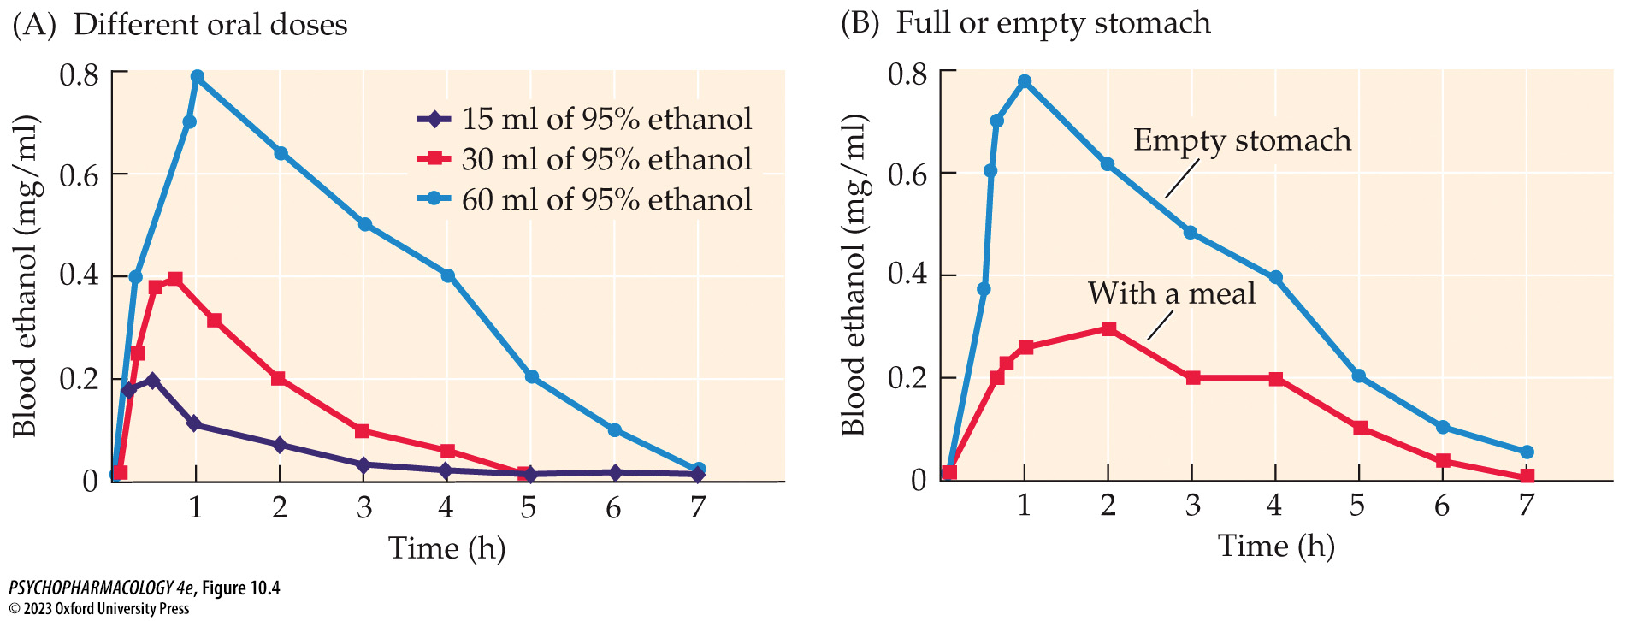
FIGURE 10.4 Blood levels of alcohol after oral administration
Notes:
FIGURE 10.4 Blood levels of alcohol after oral administration
(A) Larger oral doses of alcohol produce higher concentrations in the stomach, and this causes faster absorption and higher peak blood levels. (B) The presence of food in the stomach slows absorption of alcohol and prevents the sharp peak in blood level.

Slide 11
Psychopharmacology of Alcohol (5 of 16)
The pharmacokinetics of alcohol determines its bioavailability
About 95% of ingested alcohol is metabolized by the liver at a constant rate (1 to 1.5 ounces/hour); about 5% is excreted by the lungs—which can be measured with a Breathalyzer.
Alcohol is oxidized by alcohol dehydrogenase and aldehyde dehydrogenase (ALDH)
About 10% of Asians have genes that code for an inactive form of ALDH—drinking alcohol results in build-up of toxic acetaldehyde, causing flushing, nausea and vomiting, tachycardia, headache, dizziness, etc.
Notes:
Instructor Notes:

Slide 12
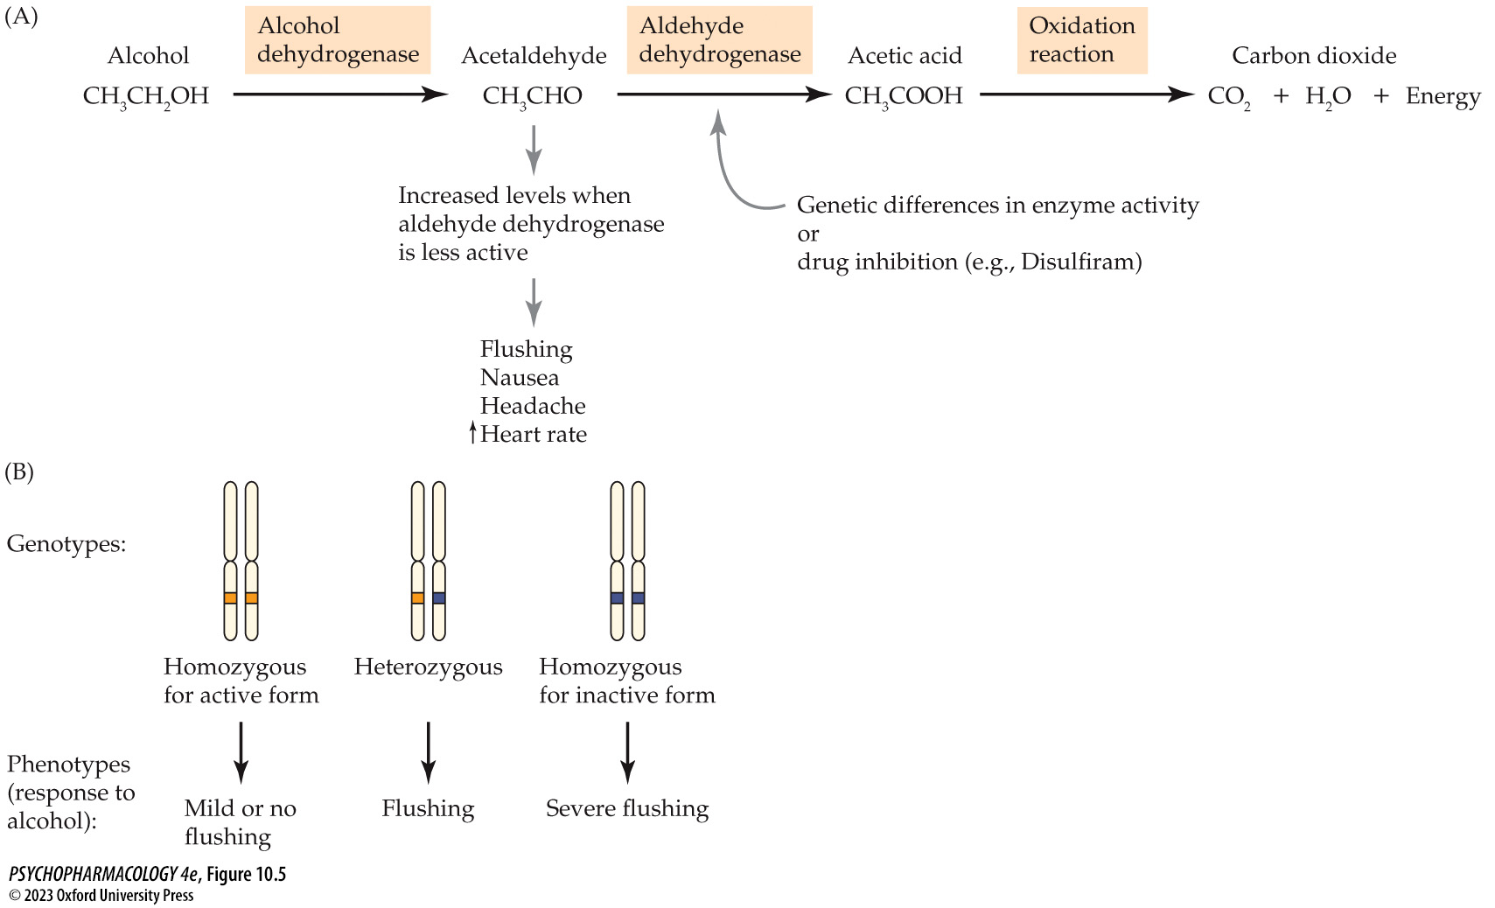
FIGURE 10.5 Metabolism of alcohol
Notes:
FIGURE 10.5 Metabolism of alcohol
(A) The principal metabolic pathway for alcohol involves the formation of the toxic metabolite acetaldehyde, which must be further degraded to acetic acid. Genetic differences in aldehyde dehydrogenase (ALDH) and the use of certain drugs can inhibit enzyme activity, causing toxic effects. (B) Three possible genetic variations of ALDH are responsible for large individual differences in response to alcohol. Each person has a pair of chromosomes with the ALDH gene—one contributed by the mother and the second by the father. The two chromosomes can have either the same form (allele), making the individual homozygous, or two different alleles, making the individual heterozygous. Individuals with two inactive alleles experience a severe reaction if they consume alcohol, because acetal­dehyde levels remain high. Those with one active and one inactive allele show some flushing response following alcohol ingestion. Two active alleles produce normal metabolism of acetaldehyde.

Slide 13
Psychopharmacology of Alcohol (6 of 16)
The pharmacokinetics of alcohol determines its bioavailability
Enzymes in the cytochrome P450 family also convert alcohol to acetaldehyde and metabolize many other drugs.
If alcohol is consumed with other drugs, they compete for the same enzyme; could lead to dangerously high levels of the other drugs
Induction: when alcohol is consumed on a regular basis, these liver enzymes increase in number, which increases the rate of metabolism of alcohol and other drugs
Notes:
Instructor Notes:
CYP2E1 is sometimes called the microsomal ethanol oxidizing system (MEOS).

Slide 14
Psychopharmacology of Alcohol (7 of 16)
Chronic alcohol use leads to both tolerance and physical dependence
Tolerance: effects of alcohol reduced when administered repeatedly
Cross-tolerance with other drugs in the sedative–hypnotic class, including barbiturates and benzodiazepines
Acute tolerance: in a single exposure; effects are greater while blood level is rising and smaller while blood level is falling; may lead to driving while intoxicated
Notes:
Instructor Notes:

Slide 15
Psychopharmacology of Alcohol (8 of 16)
Chronic alcohol use leads to both tolerance and physical dependence
Metabolic tolerance: increase in P450 liver microsomal enzymes that metabolize alcohol
Pharmacodynamic tolerance: neurons adapt to continued presence of alcohol by making compensatory changes in cell function
Behavioral tolerance: practicing behaviors while under the influence of alcohol allows adjustment and compensation
Notes:
Instructor Notes:

Slide 16
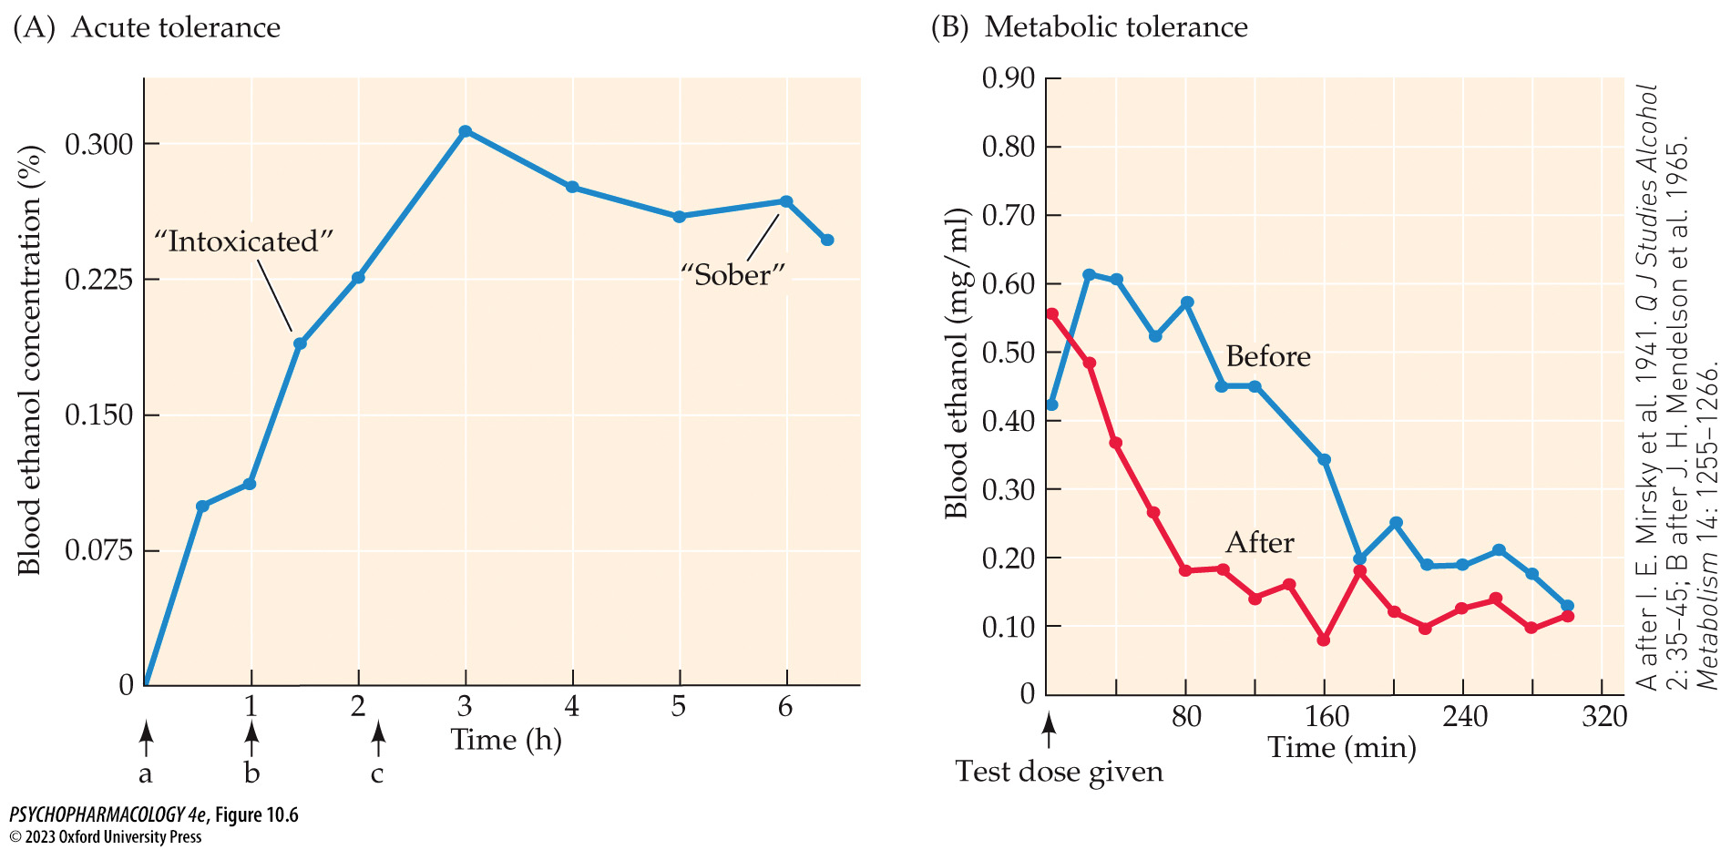
FIGURE 10.6 Tolerance to alcohol
Notes:
FIGURE 10.6 Tolerance to alcohol
(A) In a trial using a human participant given three doses of alcohol (a,b,c), signs of intoxication (such as incoordination in the balance beam test) appeared during the rising phase of blood-alcohol levels at about 0.20%. However, as blood alcohol was declining, the person became “sober” at a higher concentration (about 0.265%), showing that acute tolerance had occurred. In this case sober does not mean unimpaired in skills other than the balance beam test. Note that the high blood levels for intoxication reflect the fact that the participant was a chronically heavy user of alcohol. (B) Blood-alcohol levels were calculated at 20-minute intervals after a test dose was given at time zero. The blue line represents blood levels before a 7-day period of drinking; the red line shows blood levels in the same person after 7 days of drinking (3.2 grams of ethanol per kilogram of body weight per day in individual doses). Tolerance after repeated alcohol consumption is shown by the more rapid decrease in blood alcohol. (A after I. E. Mirsky et al. 1941. Q J Studies Alcohol 2: 35–45; B after J. H. Mendelson et al. 1965. Metabolism 14: 1255–1266.)

Slide 17
Psychopharmacology of Alcohol (9 of 16)
Chronic alcohol use leads to both tolerance and physical dependence
Physical dependence: intensity and duration of withdrawal is dependent on amount and duration of drug taking
Alcohol shows cross-dependence with other drugs in the sedative-hypnotic class
Hangover may be evidence of withdrawal or a sign of acute toxicity
Withdrawal symptoms include tremor, anxiety, high blood pressure, rapid heart rate, sweating, rapid breathing, nausea, vomiting; some people experience delirium tremens, or DTs
Notes:
Instructor Notes:

Slide 18
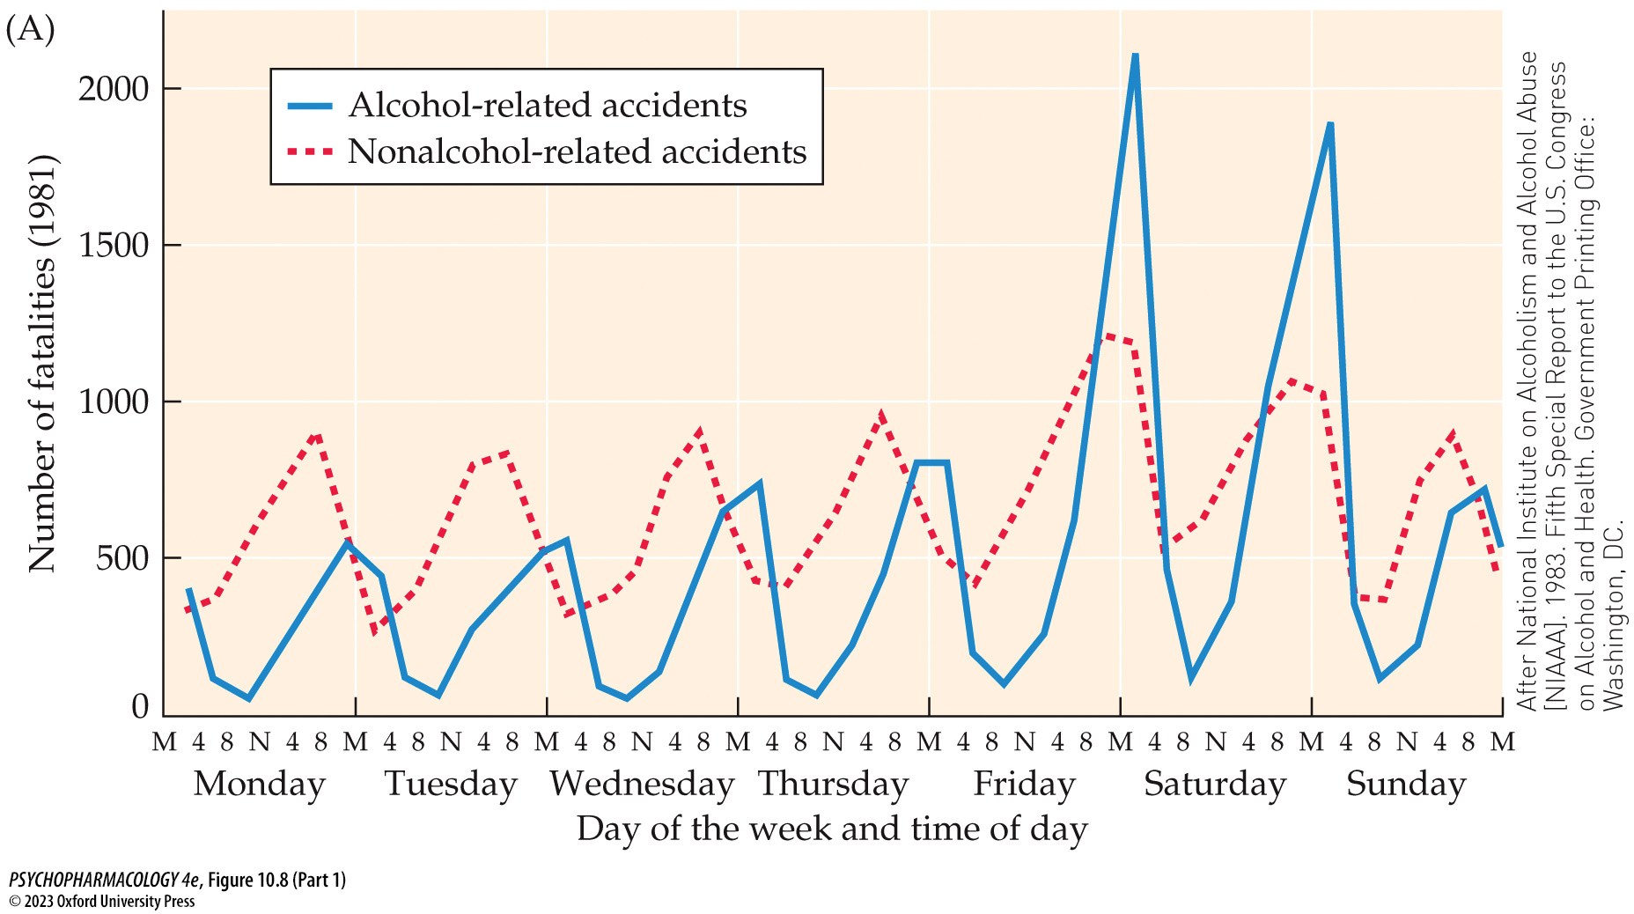
FIGURE 10.8 Relationship between alcohol use and traffic accidents (Part 1)
Notes:
FIGURE 10.8 Relationship between alcohol use and traffic accidents
(A) The number of fatal auto accidents varies by day of the week, time of day, and alcohol involvement. Note that alcohol-related fatalities peak on Friday and Saturday nights after midnight and that on other days, accidents involving alcohol also occur most frequently late at night. Non-alcohol-related fatalities appear to be greatest during rush hours on weekdays and just before midnight on weekends. (B) The relationship between BAC and relative risk for auto accidents is affected by several factors, including age of the driver and years of driving experience. Note that, in general, alcohol has a less detrimental effect on driving as drivers get older, but the 55- to 65-year age group is similar to the 25- to 34-year age group, which may indicate an interaction with age-related decreases in reaction time. The rapid rise in the number of accidents at BAC over 0.10% has prompted all states to reduce the definition of legal intoxication from 0.10% to 0.08%. M, midnight; N, noon. (A after National Institute on Alcoholism and Alcohol Abuse [NIAAA]. 1983. Fifth Special Report to the U.S. Congress on Alcohol and Health. Government Printing Office: Washington, DC; B after OECD. 1978. Road research: New research on the role of alcohol and drugs in road accidents. A report prepared by an Organization for Economic Co-operation and Development [OECD] Road Research Group.)

Slide 19
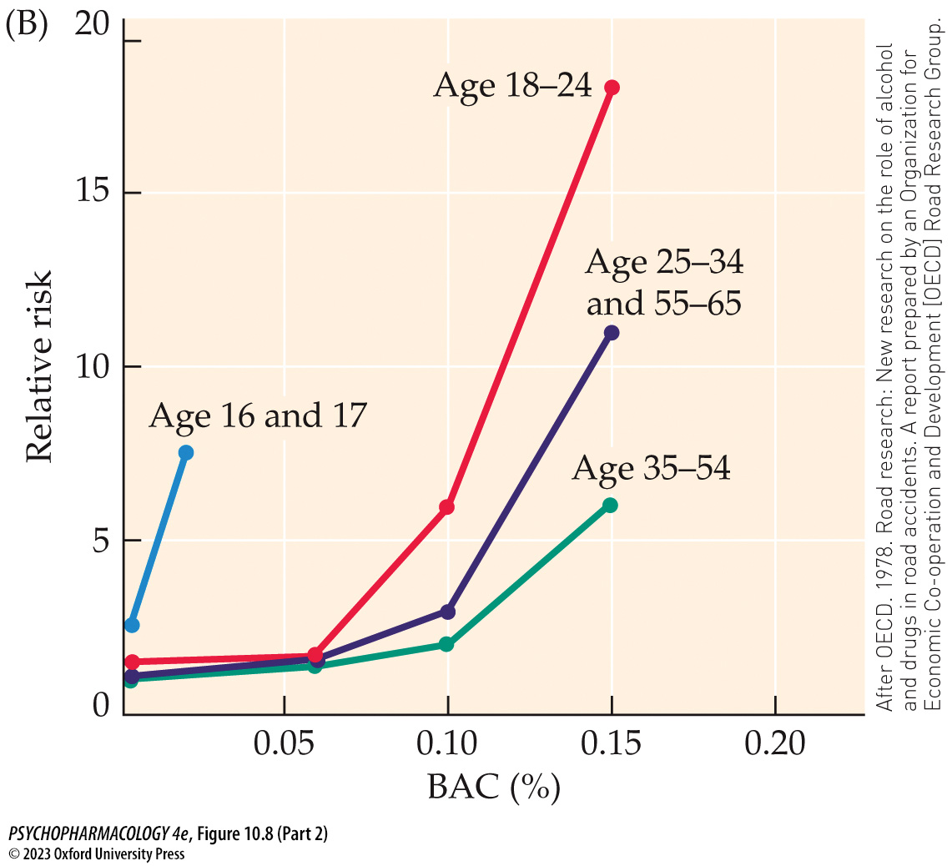
FIGURE 10.8 Relationship between alcohol use and traffic accidents (Part 2)
Notes:
FIGURE 10.8 Relationship between alcohol use and traffic accidents
(A) The number of fatal auto accidents varies by day of the week, time of day, and alcohol involvement. Note that alcohol-related fatalities peak on Friday and Saturday nights after midnight and that on other days, accidents involving alcohol also occur most frequently late at night. Non-alcohol-related fatalities appear to be greatest during rush hours on weekdays and just before midnight on weekends. (B) The relationship between BAC and relative risk for auto accidents is affected by several factors, including age of the driver and years of driving experience. Note that, in general, alcohol has a less detrimental effect on driving as drivers get older, but the 55- to 65-year age group is similar to the 25- to 34-year age group, which may indicate an interaction with age-related decreases in reaction time. The rapid rise in the number of accidents at BAC over 0.10% has prompted all states to reduce the definition of legal intoxication from 0.10% to 0.08%. M, midnight; N, noon. (A after National Institute on Alcoholism and Alcohol Abuse [NIAAA]. 1983. Fifth Special Report to the U.S. Congress on Alcohol and Health. Government Printing Office: Washington, DC; B after OECD. 1978. Road research: New research on the role of alcohol and drugs in road accidents. A report prepared by an Organization for Economic Co-operation and Development [OECD] Road Research Group.)

Slide 20
Psychopharmacology of Alcohol (10 of 16)
Alcohol affects many organ systems
Dose-dependent effects on the CNS include relaxation, reduced anxiety, intoxication, impaired judgment, impaired memory, blackouts, and sleep.
Alcohol use increases risk of automobile accidents, violent crimes, and aggression
High doses can cause alcohol poisoning, coma, and death due to respiratory depression.
Notes:
Instructor Notes:

Slide 21
Psychopharmacology of Alcohol (11 of 16)
Alcohol affects many organ systems
Heavy long-term alcohol use causes a vitamin B₁ (thiamine) deficiency leading to cell death in the periaqueductal gray, medial thalamus, and mammillary bodies, causing Wernicke’s encephalopathy (WE)
Multiple brain regions may be damaged by glutamate-induced excitotoxicity
Korsakoff syndrome: permanent damage to thalamic nuclei and brain regions involved in memory subsequent to vitamin B₁ deficiency
Other brain areas often show cell loss unrelated to diet: large ventricles indicate tissue shrinkage, small brain mass, cerebellar cell loss
Notes:
Instructor Notes:
Wernicke’s encephalopathy: tremors, weakness, ataxia, confusion, and disorientation.

Slide 22
Psychopharmacology of Alcohol (12 of 16)
Alcohol affects many organ systems
Alcohol dilates peripheral blood vessels; in the brain vasodilation may improve cognitive function in older adults
Low-to-moderate alcohol use increases the amount of “good” cholesterol in the blood while reducing the “bad”; may reduce incidence of blood clots and stroke
AUD increases the risk of high blood pressure, stroke, and heart enlargement.
Notes:
Instructor Notes:

Slide 23
Psychopharmacology of Alcohol (13 of 16)
Alcohol affects many organ systems
Alcohol has a diuretic effect, by reducing secretion of antidiuretic hormone
Alcohol increases sexual arousal while decreasing performance, increases appetite, and aids digestion by increasing gastric secretions.
Liver damage associated with AUD includes fatty liver, alcohol-induced hepatitis and cirrhosis.
Notes:
Instructor Notes:

Slide 24
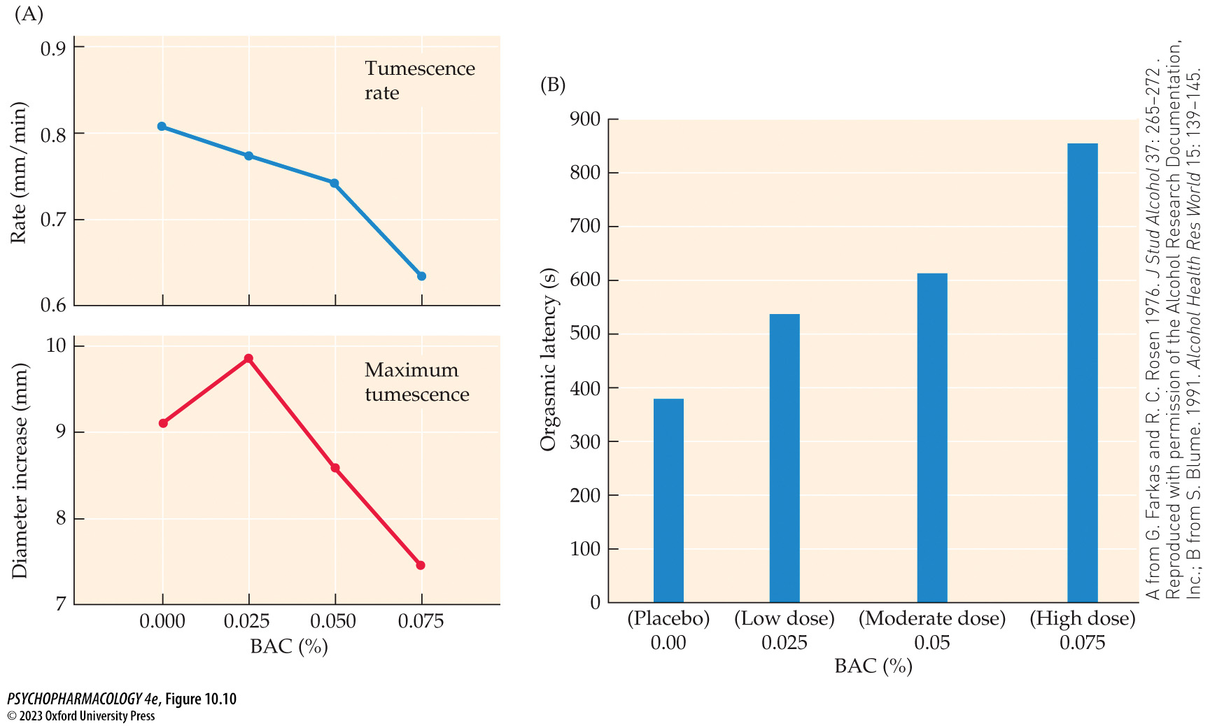
FIGURE 10.10 Effects of alcohol on sexual response
Notes:
FIGURE 10.10 Effects of alcohol on sexual response
(A) Changes in male sexual response occur after varying amounts of alcohol. With increasing concentrations of blood alcohol, both the rate of penile tumescence and the maximum size achieved decreased. (B) In women, increasing blood-alcohol levels were directly proportional to orgasmic latency. (A from G. Farkas and R. C. Rosen 1976. J Stud Alcohol 37: 265–272 . Reproduced with permission of the Alcohol Research Documentation, Inc.; B from S. Blume. 1991. Alcohol Health Res World 15: 139–145.)

Slide 25
Psychopharmacology of Alcohol (14 of 16)
Alcohol affects many organ systems
Alcohol passes through the placental barrier and the fetus quickly reaches the same BAC as the mother.
Fetal alcohol spectrum disorders (FASD) and the more severe fetal alcohol syndrome (FAS): intellectual disability and developmental delays, low birthweight, neurological problems, head and facial malformations
Notes:
Instructor Notes:

Slide 26
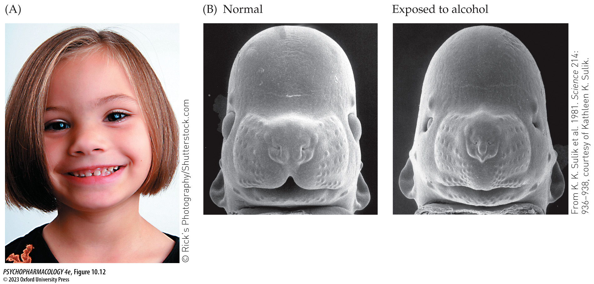
FIGURE 10.12 Fetal alcohol syndrome
Notes:
FIGURE 10.12 Fetal alcohol syndrome
(A) Distinctive craniofacial malformations in a child with FAS. (B) Fetal abnormalities in mice exposed to alcohol in utero.

Slide 27
Psychopharmacology of Alcohol (15 of 16)
Alcohol affects many organ systems
Effects of prenatal alcohol exposure depend on blood alcohol level, pattern of alcohol use, fetal developmental stage at time of exposure, maternal nutrition, genetics, and comorbid drug use.
Multiple possible mechanisms for alcohol-induced FASD have been identified, including maternal alcohol-induced epigenetic effects that alter various stages of development.
Notes:
Instructor Notes:

Slide 28
Psychopharmacology of Alcohol (16 of 16)
CLICKER QUESTION 1
Alcohol is metabolized in the liver by which two enzyme systems?
Cytochrome 450
Aldehyde dehydrogenase
Alcohol dehydrogenase
Acetaldehyde
Notes:
Instructor Notes:
Correct answer: a and c

Slide 29
Review of Learning Objectives (1 of 3)
10.1.1 Describe the pharmacokinetic fate of alcohol (absorption, distribution, metabolism, and excretion) and explain how factors such as dose and expression of metabolic enzymes affect these processes. and explain how factors such as dose, concentration of alcohol, and sex affect the rate of absorption.
10.1.2 Describe how alcohol may interact with other drugs by competing for metabolic enzymes.
10.1.3 Explain the mechanisms that underlie acute, metabolic, pharmacodynamic, and behavioral tolerance to alcohol.
10.1.4 Identify the CNS-mediated effects of alcohol in terms of dose and describe the withdrawal syndrome that occurs when an individual physically dependent on alcohol stops consuming alcohol.
10.1.5 Describe the health effects of chronic, heavy alcohol use on the brain, cardiovascular system, and liver.
10.1.6 Describe the clinical presentation of fetal alcohol spectrum disorders and list the factors that contribute to the highly varied symptom presentation.

Slide 30
Neurochemical Effects of Alcohol (1 of 10)
Animal models are vital for alcohol research
Animals are kept in controlled environments, eliminating factors such as poor nutrition, psychiatric disorders, and other drug use.
Methods can be used that are not appropriate for humans.
Prenatal alcohol studies can eliminate issues such as maternal nutrition and substance abuse.
Invasive procedures, including genetic engineering, can be used.
Animal models serve as screening tools for evaluating treatment strategies.
Notes:
Instructor Notes:

Slide 31
Neurochemical Effects of Alcohol (2 of 10)
Animal models are vital for alcohol research
Animals don’t naturally develop AUD, there is no direct animal model; only specific components of AUD can be modeled
Rodent models exist for acquisition and maintenance of drinking, physical dependence, relapse (alcohol seeking), compulsive drinking, and binge-type drinking.
Selectively bred alcohol-preferring (AP) and high-alcohol-drinking (HAD) rodents are used to evaluate behavior, neural mechanisms, and genetics of AUD.
Notes:
Instructor Notes:

Slide 32
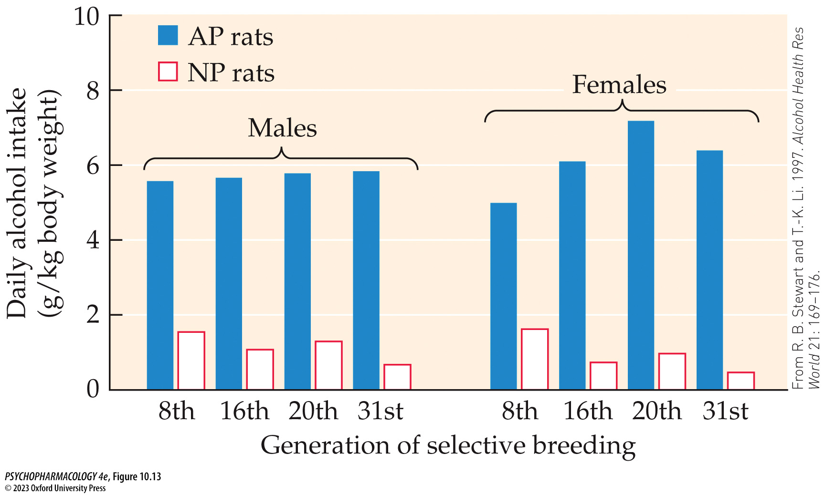
FIGURE 10.13 Average daily alcohol consumption for selected generations of rats
Notes:
FIGURE 10.13 Average daily alcohol consumption for selected generations of rats
These rats were bred for alcohol-preferring (AP) and non-preferring (NP) behavior. Males and females show similar alcohol consumption. (From R. B. Stewart and T.-K. Li. 1997. Alcohol Health Res World 21: 169–176.)

Slide 33
Neurochemical Effects of Alcohol (3 of 10)
Animal models are vital for alcohol research
AP and HAD rat strains have helped identify genes that influence alcohol consumption
Experimental results indicate a role for the mGluR2 glutamate receptor in alcohol reinforcement
mGluR2-knockout mice show increased alcohol consumption and preference over wild-type mice
Notes:
Instructor Notes:

Slide 34
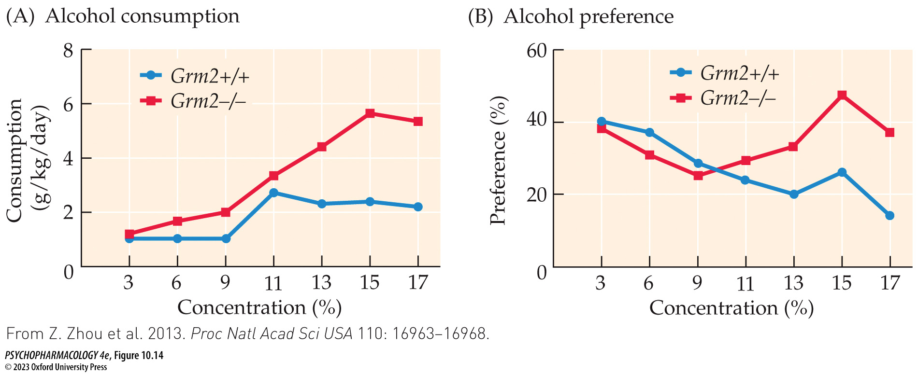
FIGURE 10.14 Grm2-knockout mice show increased alcohol consumption and preference
Notes:
FIGURE 10.14 Grm2-knockout mice show increased alcohol consumption and preference
(A) Homozygous knockout mice (Grm2−/−) drink increasing amounts of alcohol as the alcohol concentration increases from 3% to 17%. Wild-type controls (Grm2+/+) consume significantly less than the knockout mice at the higher concentrations. (B) Grm2−/− mice showed a consistent percent preference for alcohol over water in a two-bottle free-choice situation, even at high alcohol concentrations, while control mice reduced their preference for alcohol at high concentrations. (From Z. Zhou et al. 2013. Proc Natl Acad Sci USA 110: 16963–16968.)

Slide 35
Neurochemical Effects of Alcohol (4 of 10)
Alcohol acts on multiple neurotransmitters
Nonspecific actions: cell membrane lipids become more fluid; changes its relationship with membrane proteins
Specific actions: influences ligand-gated channels and alters second-messenger systems
Notes:
Instructor Notes:

Slide 36
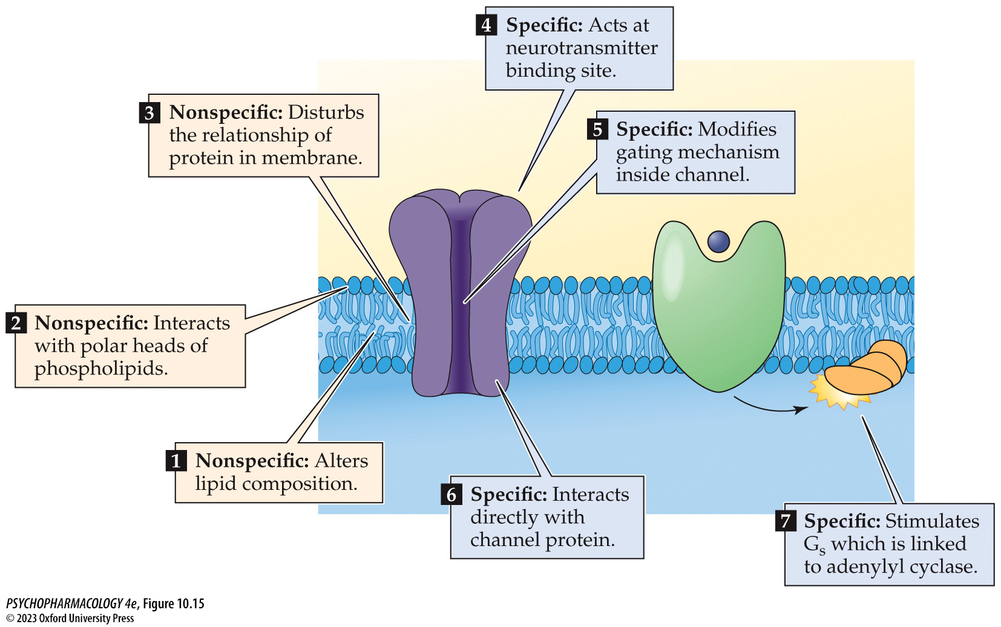
FIGURE 10.15 Effects of alcohol on neuronal membranes
Notes:
FIGURE 10.15 Effects of alcohol on neuronal membranes
Alcohol acts at both specific and nonspecific sites, including membrane phospholipids, ligand-gated channels, and second-messenger systems.

Slide 37
Neurochemical Effects of Alcohol (5 of 10)
Alcohol acts on multiple neurotransmitters
Glutamate: acute alcohol reduces its effect on NMDA receptors; reduces glutamate release in many brain areas; repeated use results in up-regulation of NMDA receptors
During withdrawal, glutamate release increases, correlated with CNS hyperexcitability and seizures; excessive Ca²⁺ influx contributes to cell death.
Frequently experienced withdrawal may be responsible for some irreversible brain damage.
Notes:
Instructor Notes:

Slide 38
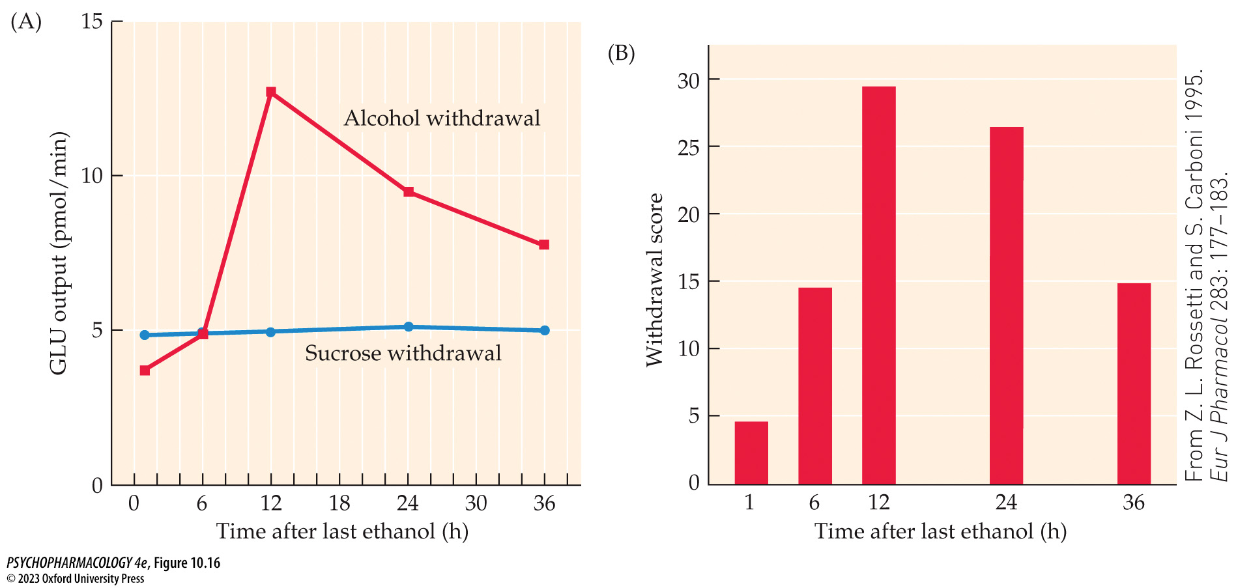
FIGURE 10.16 Relationship between alcohol withdrawal and glutamate release
Notes:
FIGURE 10.16 Relationship between alcohol withdrawal and glutamate release
Withdrawal from chronic alcohol in dependent rats increases glutamate (GLU) release in the striatum (A) and behavioral rebound withdrawal hyperexcitability (B). The time course of the two withdrawal-related events is very similar. Experimental animals received intragastric delivery of ethanol at intoxicating concentrations (2–5 g/kg) every 6 hours for 6 consecutive days. Control animals received an equally caloric sucrose solution. On day 7, ethanol administration was terminated, and behavioral testing of abstinence signs and simultaneous microdialysis collection began. (From Z. L. Rossetti and S. Carboni 1995. Eur J Pharmacol 283: 177–183.)

Slide 39
Neurochemical Effects of Alcohol (6 of 10)
Alcohol acts on multiple neurotransmitters
GABA: alcohol increases GABA-induced Cl⁻ flux and hyper-polarization; also stimulates GABA release
Some receptors respond to low doses of alcohol in a persistent fashion to the GABA that remains in the extracellular space; may have a role in reinforcing effects.
Repeated exposure to ethanol reduces GABA_{A}-mediated Cl– flux; may contribute to tolerance and withdrawal
Alcohol also impacts metabotropic GABA_{B} receptors
Notes:
Instructor Notes:

Slide 40
Neurochemical Effects of Alcohol (7 of 10)
Alcohol acts on multiple neurotransmitters
Dopamine: activates dopaminergic cells in the VTA, causing release of DA in the NAcc, which is involved in positive reinforcement
Increased dopaminergic transmission in the mesolimbic pathway occurs in response to most drugs of abuse, including alcohol
In rodents, withdrawal after chronic alcohol use reduces firing rate of mesolimbic neurons and decreases DA release in the Nacc
Reduction in mesolimbic DA is also reflected in a rebound depression of reinforcement mechanisms
Notes:
Instructor Notes:

Slide 41
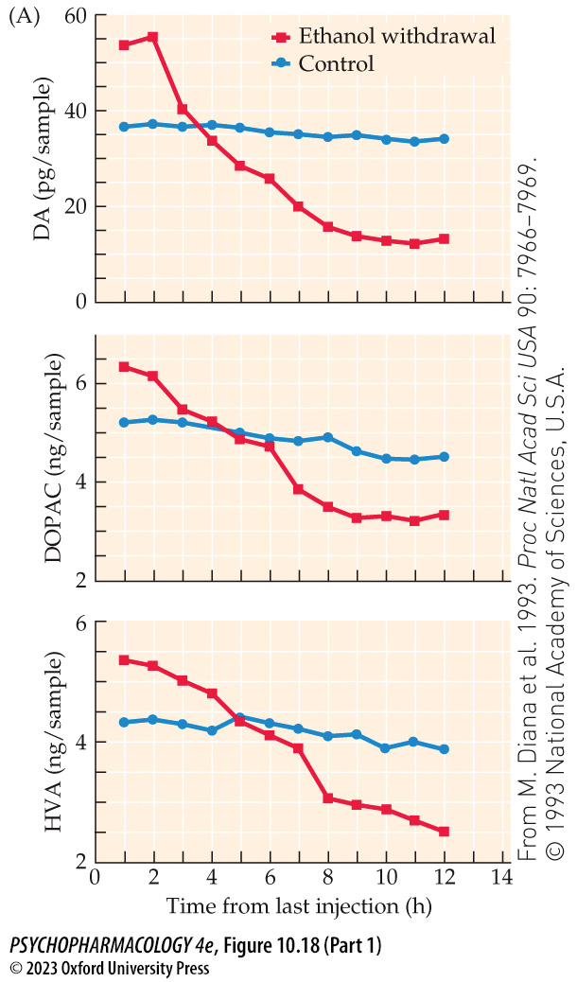
FIGURE 10.18 Dopamine turnover and alcohol withdrawal (Part 1)
Notes:
FIGURE 10.18 Dopamine turnover and alcohol withdrawal
(A) Microdialysis collection of DA and its major metabolites, DOPAC and HVA, in the NAcc of rats at varying times after ethanol withdrawal shows significant reduction in DA turnover compared with control. (B) Development of abstinence signs in the same animals. Note the similarity in time course of biochemical measures and the occurrence of behavioral signs. The alcohol group received intoxicating doses of alcohol every 6 hours for 6 days before withdrawal. Control animals received sucrose of caloric value equal to the alcohol. The microdialysis collection of extra­cellular fluid and the behavioral measures of abstinence occurred at various times over the 12-hour period following ethanol withdrawal. Withdrawal scores were a composite of separate measures of tremor, vocalization on handling, bracing posture, rigidity, and others. (From M. Diana et al. 1993. Proc Natl Acad Sci USA 90: 7966–7969. © 1993 National Academy of Sciences, U.S.A.)

Slide 42
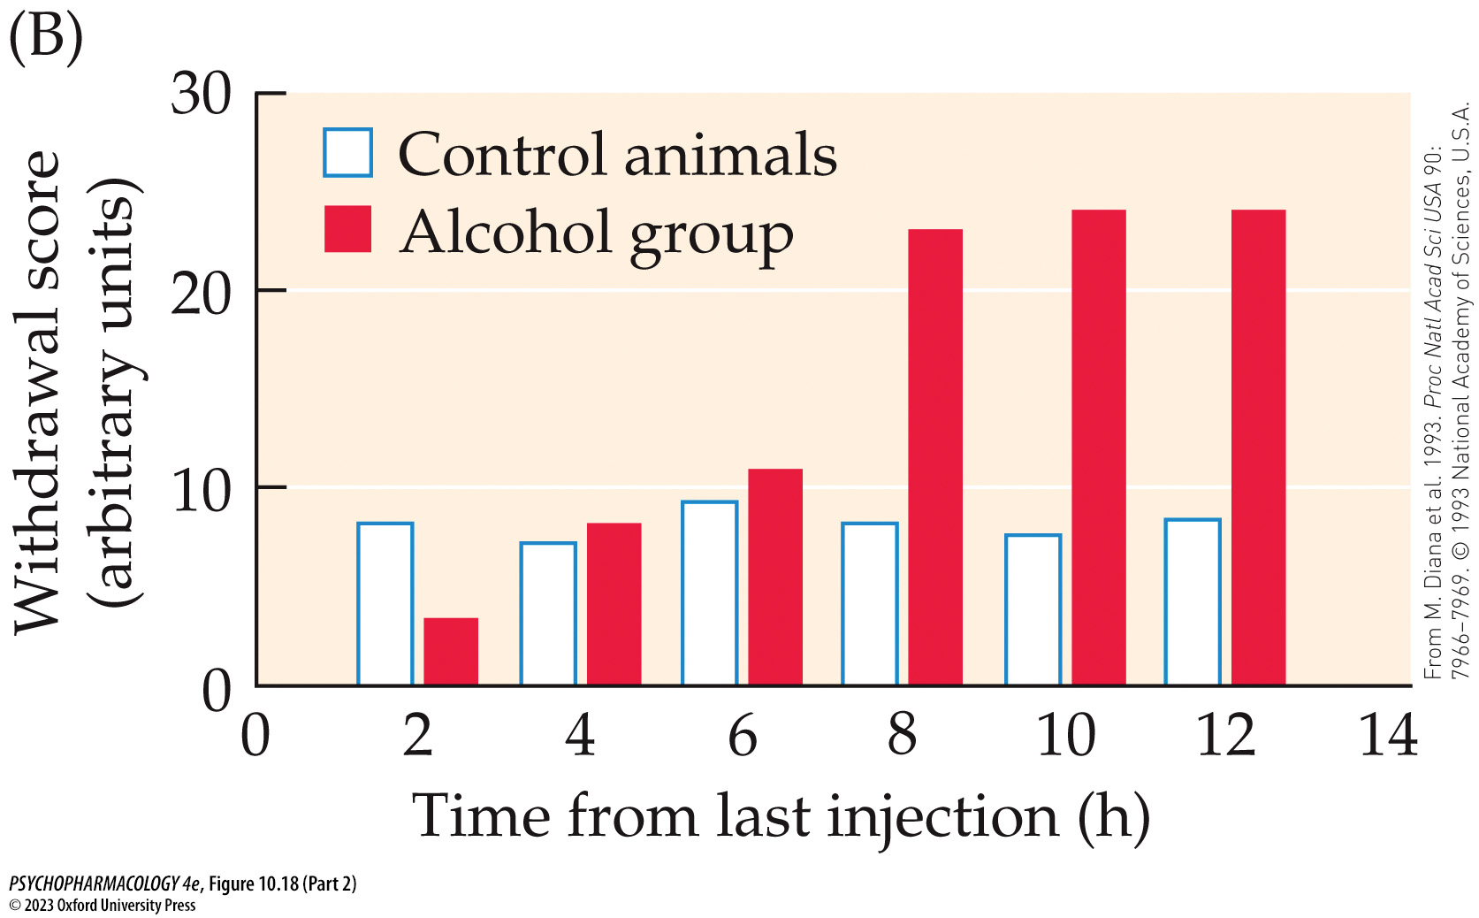
FIGURE 10.18 Dopamine turnover and alcohol withdrawal (Part 2)
Notes:
FIGURE 10.18 Dopamine turnover and alcohol withdrawal
(A) Microdialysis collection of DA and its major metabolites, DOPAC and HVA, in the NAcc of rats at varying times after ethanol withdrawal shows significant reduction in DA turnover compared with control. (B) Development of abstinence signs in the same animals. Note the similarity in time course of biochemical measures and the occurrence of behavioral signs. The alcohol group received intoxicating doses of alcohol every 6 hours for 6 days before withdrawal. Control animals received sucrose of caloric value equal to the alcohol. The microdialysis collection of extra­cellular fluid and the behavioral measures of abstinence occurred at various times over the 12-hour period following ethanol withdrawal. Withdrawal scores were a composite of separate measures of tremor, vocalization on handling, bracing posture, rigidity, and others. (From M. Diana et al. 1993. Proc Natl Acad Sci USA 90: 7966–7969. © 1993 National Academy of Sciences, U.S.A.)

Slide 43
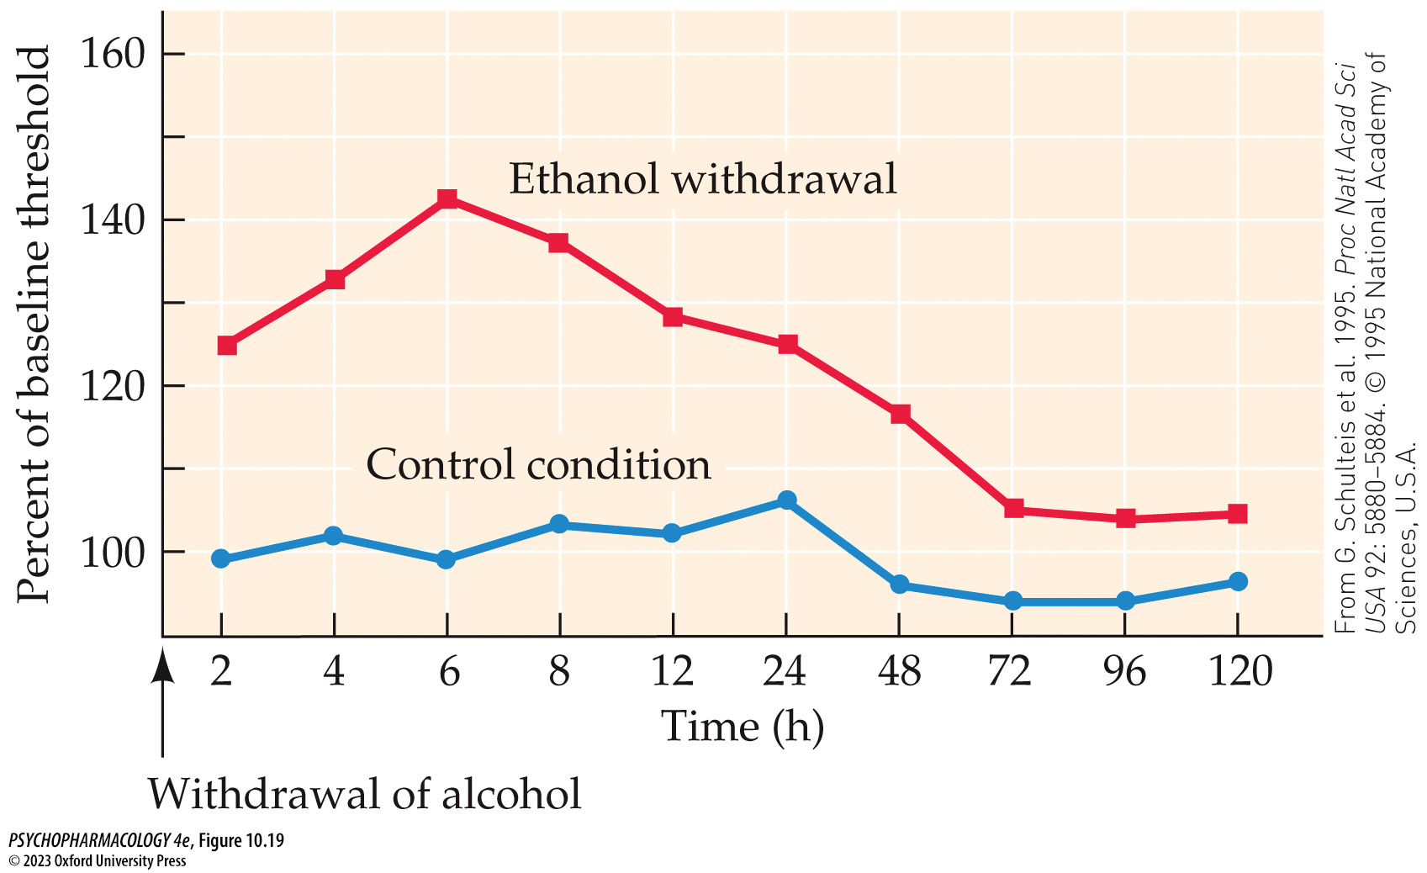
FIGURE 10.19 Rebound depression of reinforcement during withdrawal
Notes:
FIGURE 10.19 Rebound depression of reinforcement during withdrawal
After alcohol withdrawal from dependent rats, a time-dependent increase in the current thresholds for electrical brain stimulation occurs, with maximum effect at 6 to 8 hours. The increase in threshold indicates that the animals need more stimulation to achieve reinforcement. Note that the x-axis is not a linear scale. (From G. Schulteis et al. 1995. Proc Natl Acad Sci USA 92: 5880–5884. © 1995 National Academy of Sciences, U.S.A.)

Slide 44
Neurochemical Effects of Alcohol (8 of 10)
Alcohol acts on multiple neurotransmitters
Opioid systems: endorphins contribute to the reinforcing effects of alcohol; enhances release from the pituitary gland
But chronic alcohol use reduces gene expression, making less endogenous opioids available for release
Blocking opioid receptors reduces alcohol self-administration. μ-opioid receptor knockout mice fail to self-administer ethanol.
High levels of μ-opioid receptors correlate with scores on craving
AP rats release more opioids in response to alcohol and show enhanced opioid gene expression.
Notes:
Instructor Notes:

Slide 45
Neurochemical Effects of Alcohol (9 of 10)
Alcohol acts on multiple neurotransmitters
Other transmitters: many more interacting neurotransmitter systems have been implicated in the action of alcohol
Alcohol can cause changes in cell signaling, including those regulated by second messengers.
Phosphorylation of transcription factor CREB may be responsible for long-term changes in cell function, including altered gene expression.
Notes:
Instructor Notes:

Slide 46
Neurochemical Effects of Alcohol (10 of 10)
CLICKER QUESTION 2
Acute alcohol administration _______ the effect of glutamate at NMDA receptors, and _______ glutamate release in the brain.
increases; increases
increases; decreases
decreases; decreases
decreases; increases
Notes:
Instructor Notes:
Correct answer: c

Slide 47
Review of Learning Objectives (2 of 3)
10.2.1 Describe how animal models can be used to examine the behavioral, neural, and genetic bases of AUD.
10.2.2 Explain how alcohol acutely modulates glutamate neurotransmission, in terms of both pre- and post-synaptic mechanisms.
10.2.3 Describe how the effects of chronic alcohol use on glutamate neurotransmission contribute to excitotoxicity and reduced seizure threshold during withdrawal.
10.2.4 Explain how alcohol acutely enhances GABA-mediated neural inhibition.
10.2.5 Describe how chronic alcohol consumption alters GABAergic neurotransmission.
10.2.6 Identify the evidence for the role of mesolimbic dopamine and brain opioid systems in mediating the reinforcing properties of alcohol.

Slide 48
Alcohol Use Disorder (AUD) (1 of 12)
Defining AUD and estimating its incidence have proved difficult
AUD is difficult to define: frequency and pattern of use are as significant as the total amount consumed
Binge drinking: drinking five drinks in a row (men) or four (women)
Diagnosis of AUD depends on identifying a cluster of behavioral, cognitive, and physical characteristics
For a clinician, the essential features of AUD are compulsive alcohol seeking and use despite damaging consequences
Notes:
Instructor Notes:

Slide 49
Alcohol Use Disorder (AUD) (2 of 12)
Defining AUD and estimating its incidence have proved difficult
Attempts to classify subtypes of alcohol users based on alcohol-induced defining characteristics:
  Type I and II
  Type A and B
Different definitions of AUD have led to large differences in estimated incidence; commonly accepted statistic: about 10% of Americans have some problem with alcohol use
Notes:
Instructor Notes:

Slide 50
Alcohol Use Disorder (AUD) (3 of 12)
Defining AUD and estimating its incidence have proved difficult
College-age students: increases in alcohol-related injuries and death from overdose; significant number report alcohol-related problems but only 1% believed they had a drinking problem
The younger individuals are when they begin drinking (< 13), the greater the probability they will develop AUD; early drinking also predicts other risky behaviors
Adolescents more vulnerable to alcohol-induced neurological deficits
Notes:
Instructor Notes:

Slide 51
Alcohol Use Disorder (AUD) (4 of 12)
The causes of AUD are multimodal
No specific cause of AUD has been identified; a variety of factors contribute to vulnerability of any given individual
Psychological factors:
  Stress reduces or increases alcohol consumption under different conditions
  Family history
  Lifetime anxiety, especially early in life
  Personality/novelty seeking and risk taking
Notes:
Instructor Notes:

Slide 52
Alcohol Use Disorder (AUD) (5 of 12)
The causes of AUD are multimodal
Neurobiological factors: genetic vulnerability – close relatives of AUD individuals have 3 to 7 times greater risk for AUD than the general population0
Methods used to find genetic patterns in humans:
  Twin and adoption studies
  Linkage studies: low sensitivity to alcohol is a risk factor for AUD
  Case–control method, a type of association analysis
  Genome-wide association studies (GWAS)
  Selectively bred and knockout rodents
Notes:
Instructor Notes:

Slide 53
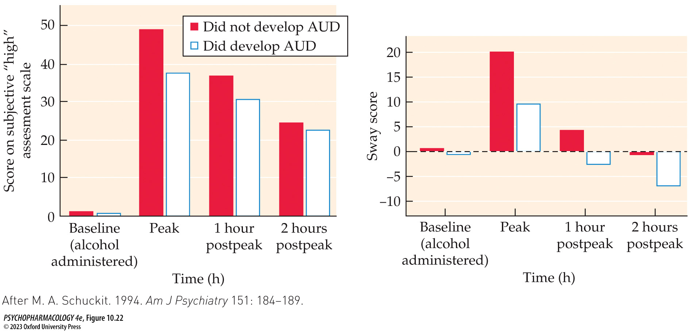
FIGURE 10.22 Low sensitivity to alcohol is a risk factor for AUD
Notes:
FIGURE 10.22 Low sensitivity to alcohol is a risk factor for AUD
Subjective assessment of “high” and sway scores following a moderate dose (0.75 ml/kg) of alcohol in men who later developed alcohol dependence and in those who did not. Those vulnerable to alcohol dependence showed significantly less response to the same dose at peak blood level (1 hour) and 1 and 2 hours after the peak. (After M. A. Schuckit. 1994. Am J Psychiatry 151: 184–189.)

Slide 54
Alcohol Use Disorder (AUD) (6 of 12)
The causes of AUD are multimodal
Sociocultural factors mold attitudes about drinking
Cultures that abstain from alcohol use or restrict it for religious purposes have the lowest AUD rates.
Societies in which social drinking in public settings is condoned and drinking for personal reasons such as tension reduction have higher AUD rates.
Notes:
Instructor Notes:

Slide 55
Alcohol Use Disorder (AUD) (7 of 12)
Multiple treatment options provide hope for rehabilitation
Detoxification: withdrawal symptoms are strong motivators and can be dangerous. BZDs such as chlordiazepoxide (Librium) or diazepam (Valium) prevent symptoms
Psychosocial rehabilitation programs
  Individual and group therapy
  Residential alcohol-free treatment settings
  Self-help groups such as Alcoholics Anonymous (AA)
  Community reinforcement approach (CRA)
  Cognitive behavior therapy
Notes:
Instructor Notes:

Slide 56
Alcohol Use Disorder (AUD) (8 of 12)
Multiple treatment options provide hope for rehabilitation
Pharmacotherapeutic treatment includes two strategies: make drinking unpleasant and reduce alcohol’s reinforcing qualities.
Disulfiram (Antabuse) inhibits ALDH (converts acetaldehyde to acetic acid). Drinking even 1 oz of alcohol results in flushing, pounding heart, nausea, vomiting, etc.
Naltrexone: an opioid receptor antagonist; reduces the “high” by blocking the effects of alcohol-induced endorphin release
Notes:
Instructor Notes:

Slide 57
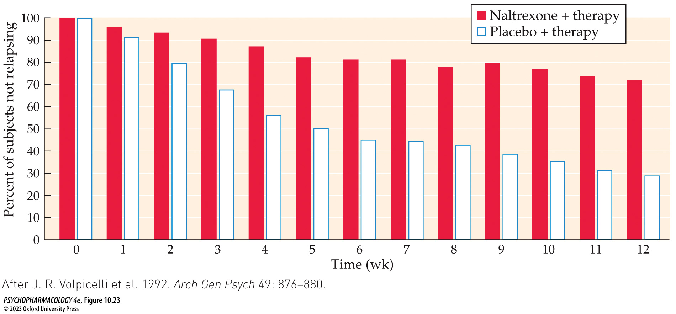
FIGURE 10.23 Effectiveness of naltrexone in treatment of AUD
Notes:
FIGURE 10.23 Effectiveness of naltrexone in treatment of AUD
Naltrexone along with coping skills therapy is more effective in preventing relapse than placebo and therapy over a 12-week period. At 12 weeks, relapse rates were approximately 70% for the placebo group compared with 30% for the naltrexone treatment group. (After J. R. Volpicelli et al. 1992. Arch Gen Psych 49: 876–880.)

Slide 58
Alcohol Use Disorder (AUD) (9 of 12)
Multiple treatment options provide hope for rehabilitation
Nalmefene: κ- and μ-opioid receptor modulator; it was found to be more effective than naltrexone in animal studies.
Acamprosate: partial antagonist at glutamate NMDA receptors; significantly blocks the glutamate increase that occurs during alcohol withdrawal in rats.
Notes:
Instructor Notes:

Slide 59
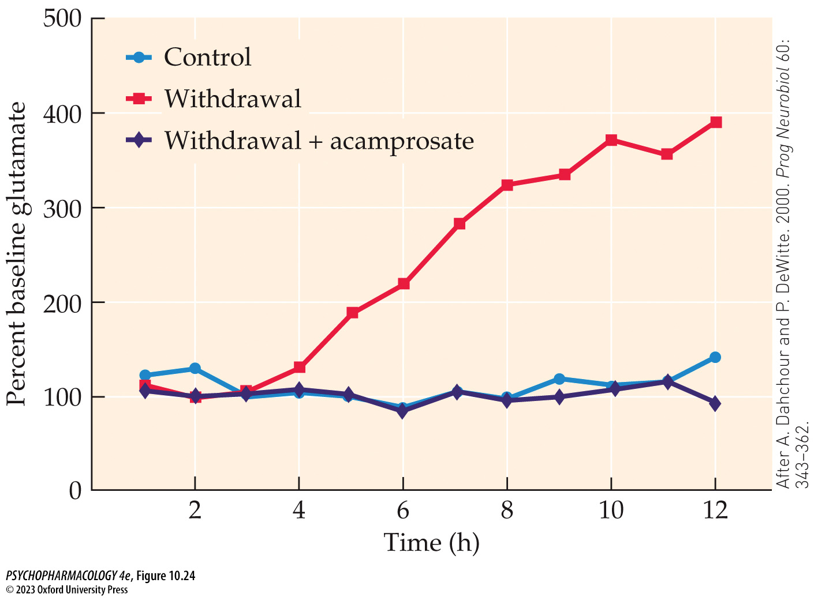
FIGURE 10.24 Acamprosate prevents withdrawal-induced glutamate release
Notes:
FIGURE 10.24 Acamprosate prevents withdrawal-induced glutamate release
The red squares plot line shows the rebound release of glutamate (measured by microdialysis) that occurs in the nucleus accumbens when alcohol is withdrawn from dependent rats. Alcohol-dependent animals no longer receiving alcohol but receiving acamprosate (purple diamond plot line) are no different in glutamate release from non-­alcohol-treated controls. (After A. Dahchour and P. DeWitte. 2000. Prog Neurobiol 60: 343–362.)

Slide 60
Alcohol Use Disorder (AUD) (10 of 12)
Multiple treatment options provide hope for rehabilitation
Possible new treatments:
  CRF₁ antagonists: repeated episodes of intoxication and withdrawal lead to increased CRF₁ receptors in the amygdala, sensitization of the reactivity to stressors, and significantly elevated rates of alcohol consumption.
  Glucocorticoid receptor (GR) antagonist: reduced alcohol self-administration and craving
  Ketamine: NMDA glutamate receptor antagonist: could reverse the hyperexcitable state in withdrawal
Notes:
Instructor Notes:

Slide 61
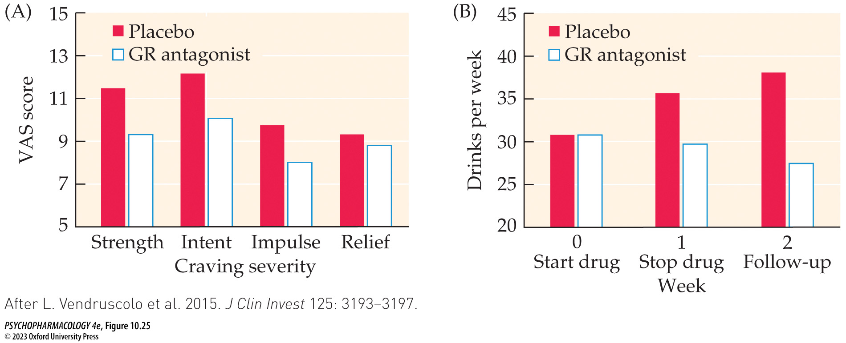
FIGURE 10.25 Glucocorticoid receptor (GR) antagonism reduced alcohol-cued craving and drinking in dependent individuals
Notes:
FIGURE 10.25 Glucocorticoid receptor (GR) antagonism reduced alcohol-cued craving and drinking in dependent individuals
(A) Visual analog scale (VAS) scores on four VAS measures of craving severity following presentation of alcohol-related cues. Strength: How strong is your craving to drink alcohol? Intent: If I could drink alcohol now, I would drink it. Impulse: It would be hard to turn down a drink right now. Relief: Having a drink would make things just perfect. Higher scores indicate greater craving. Significant differences were reported for strength, intent, and impulse. (B) Total number of alcoholic drinks consumed per week for individuals treated with the GR antagonist or placebo at baseline, following treatment, and at 2-week follow-up. (After L. Vendruscolo et al. 2015. J Clin Invest 125: 3193–3197.)

Slide 62
Alcohol Use Disorder (AUD) (11 of 12)
Multiple treatment options provide hope for rehabilitation
Combining Medications and Behavioral Interventions (COMBINE): controlled clinical trial of treatments utilizing almost 1400 alcohol-dependent study participants
Four treatments: naltrexone, acamprosate, medical management, and combined behavioral intervention (CBI).
Most effective was medical management along with either naltrexone or CBI
Notes:
Instructor Notes:

Slide 63
Alcohol Use Disorder (AUD) (12 of 12)
CLICKER QUESTION 3
Disulfiram is used to treat AUD because it
inhibits aldehyde dehydrogenase.
blocks the mGluR2 glutamate receptor.
blocks μ-opioid receptors.
blocks acetaldehyde build up in the blood.
Notes:
Instructor Notes:
Correct answer: a

Slide 64
Review of Learning Objectives (3 of 3)
10.3.1 Articulate the properties of pathological drinking behavior that give rise to alcohol use disorder (AUD).
10.3.2 Identify the neurobiological changes caused by underage drinking.
10.3.3 Describe how neurobiological, psychological, and societal factors contribute to individual vulnerability for AUD.
10.3.4 Explain how medically supervised detoxification is conducted to mitigate risks associated with alcohol withdrawal.
10.3.5 Describe the mechanisms of action of the three pharmacotherapies for AUD currently approved by the FDA.

